Slide 1

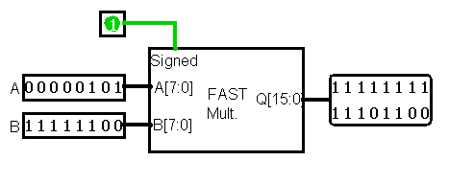

Fast Multiplier
"This presentation is brought to you by…"
Riley Guidry
Alberto Rosas
Dang Tran
All made possible with…
Notes:
title slide needs more work
- add images
- infomercial aesthetic

Slide 2
Table of Contents
Overview
Basic Gates
2x1 Multiplexer
Half Adder
2's Complement
Full Adder
6 Adder & 8-bit AND
Partial Product
Multiplier
8-bit Fast Multiplier

Slide 3
Overview
The fast multiplier utilizes the Wallace tree method, a high-speed multiplier architecture that performs fast multiplication of binary numbers. It efficiently reduces the number of partial products and optimizes the addition process using a structured tree-based approach. This results in reduced critical path delay and improved overall performance compared to traditional multiplication algorithms, especially for large operands.

Slide 4
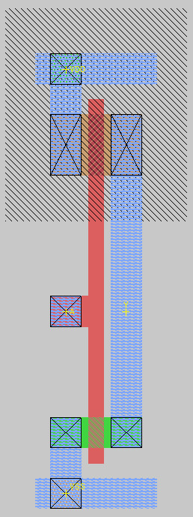
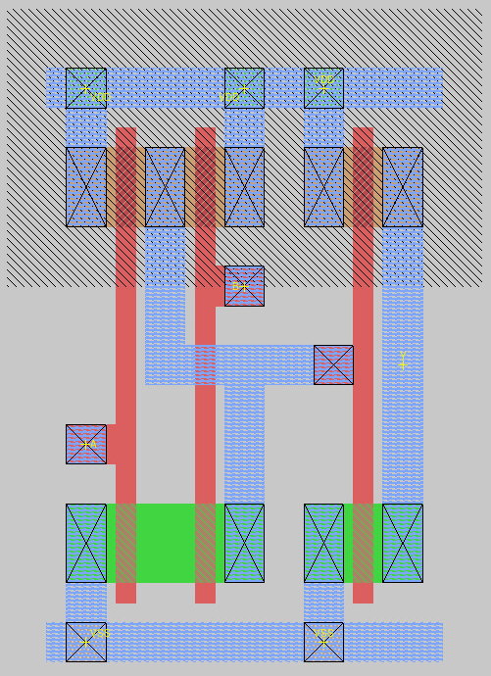
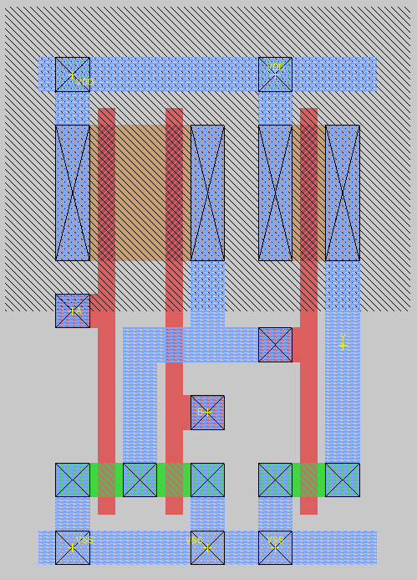
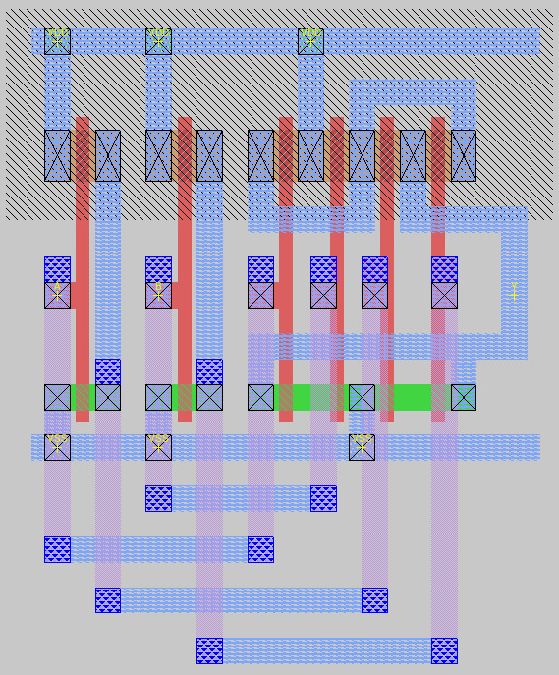
Basic Gates
INV
AND-2
OR-2
XOR-2

Slide 5
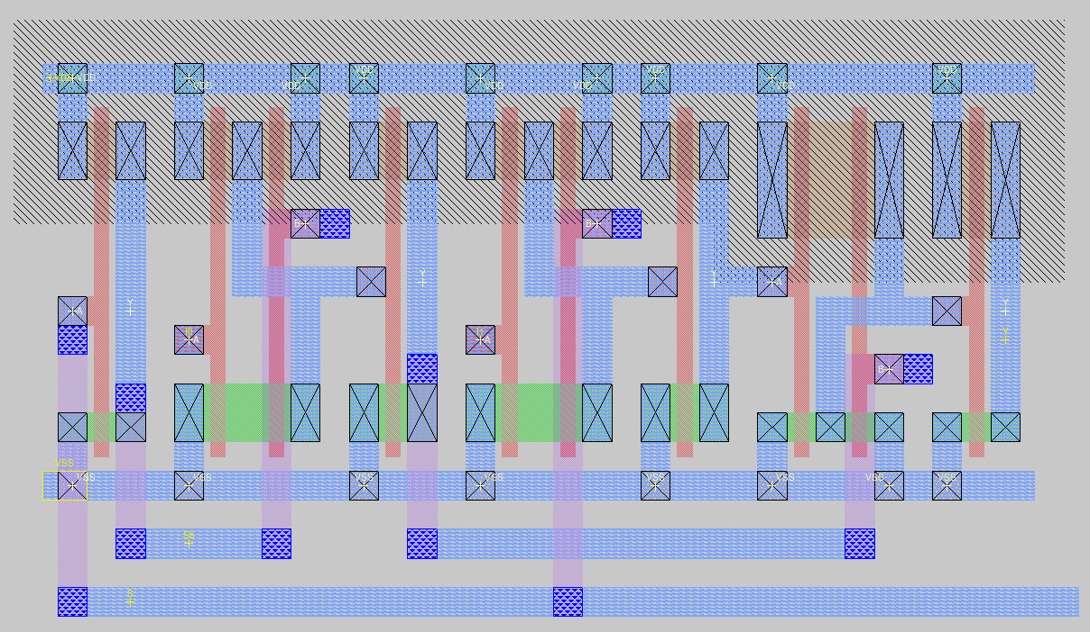
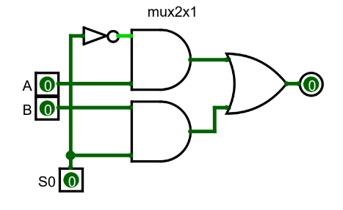
1-bit 2x1 MUX

Slide 6
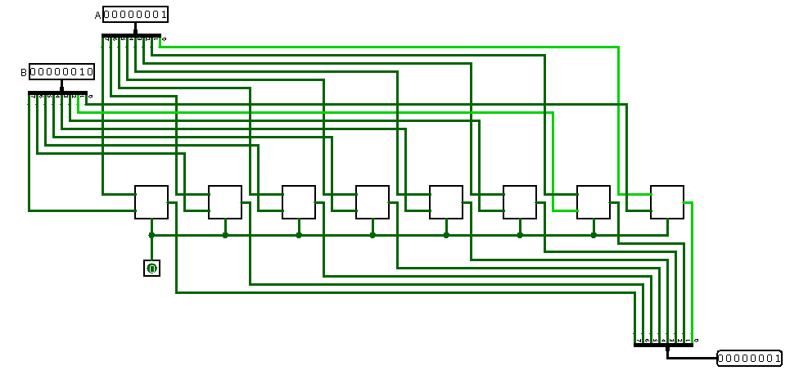
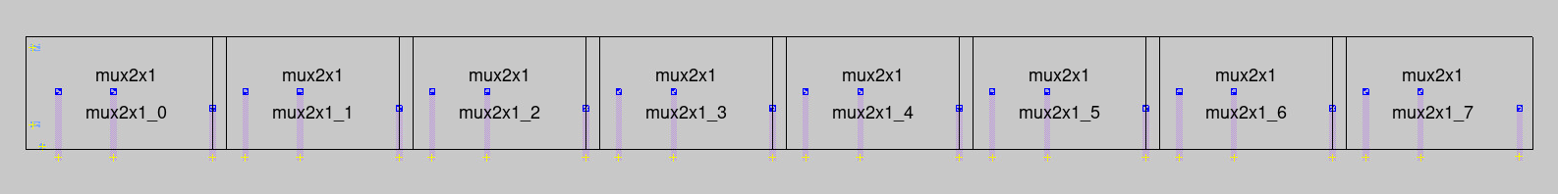
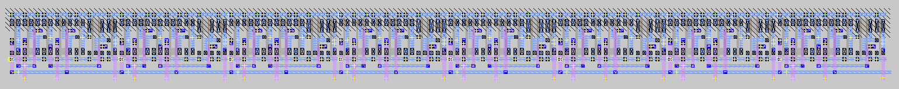
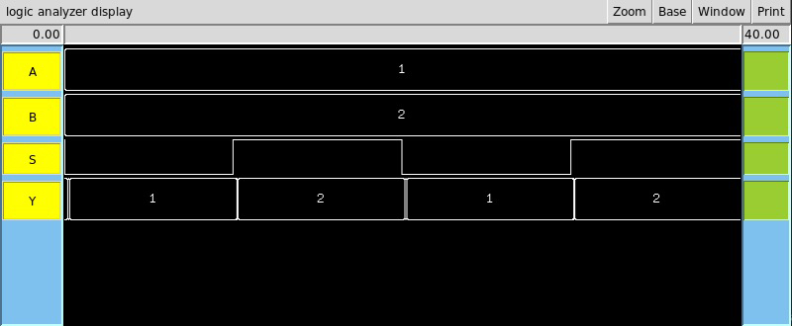
8-bit 2x1 Multiplexer
Notes:
click to clear the logisim schematic then show magic layout

Slide 7
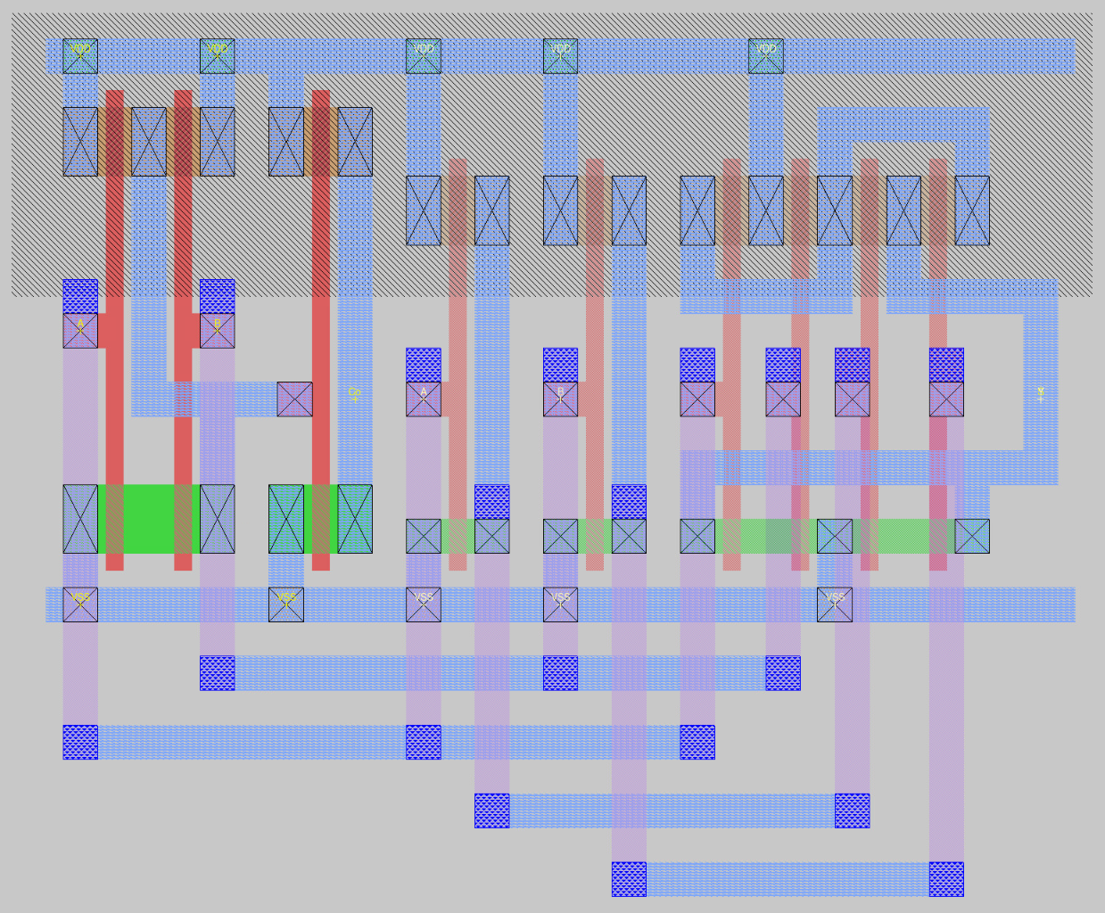
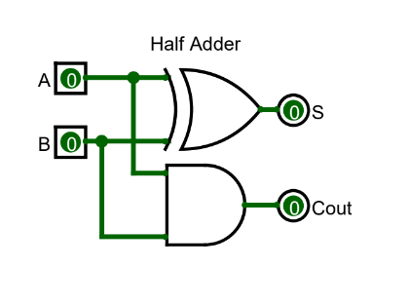
Half Adder

Slide 8
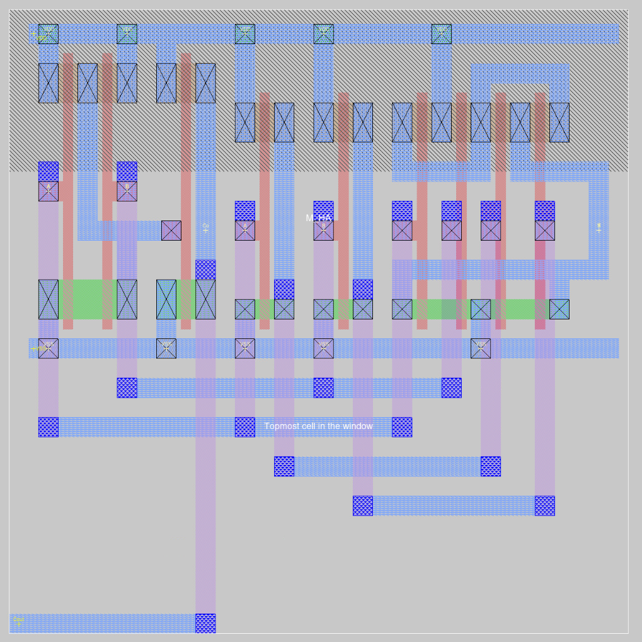
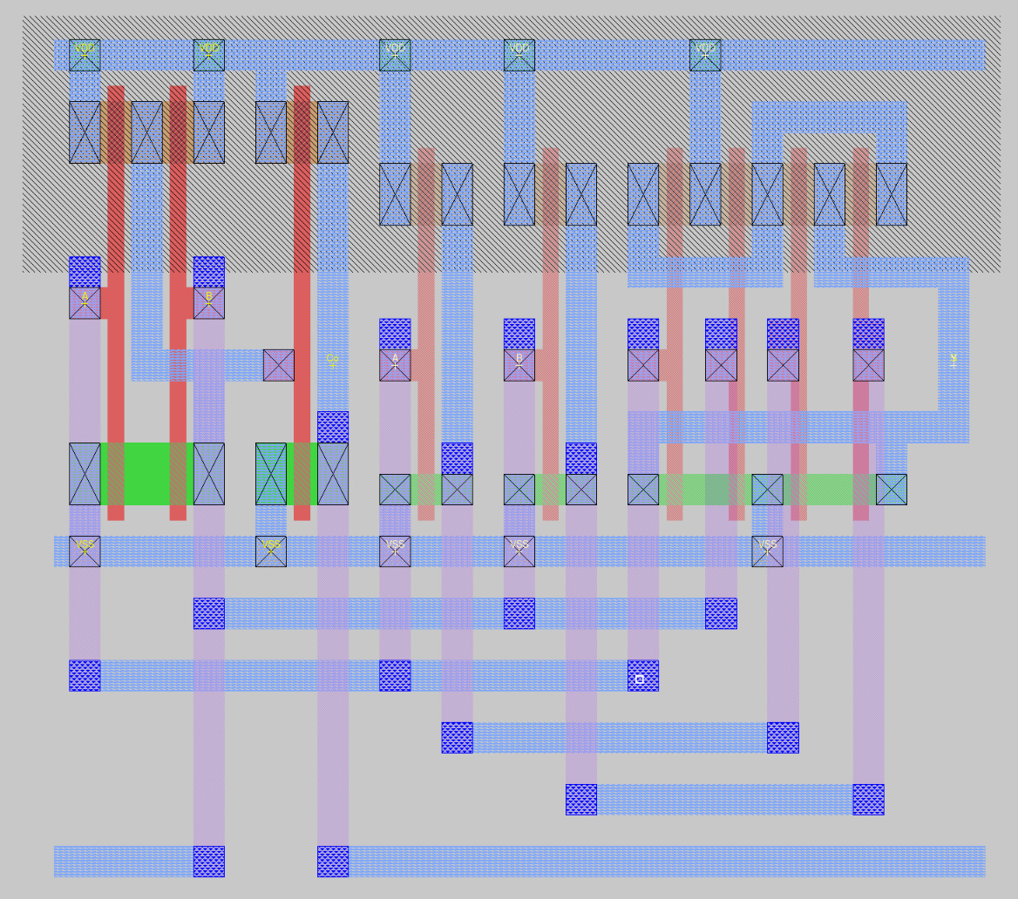
Versions of Half Adder
M_HA
Chain_HA

Slide 9
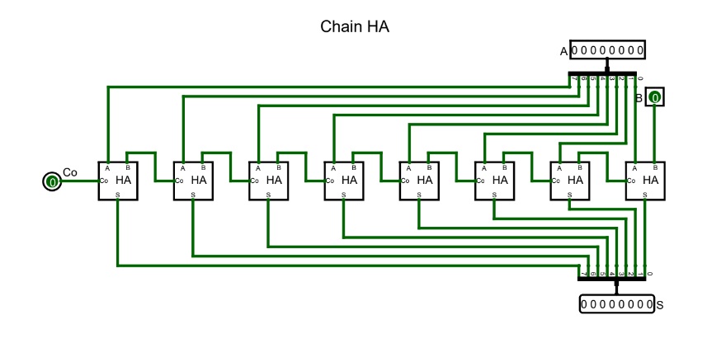
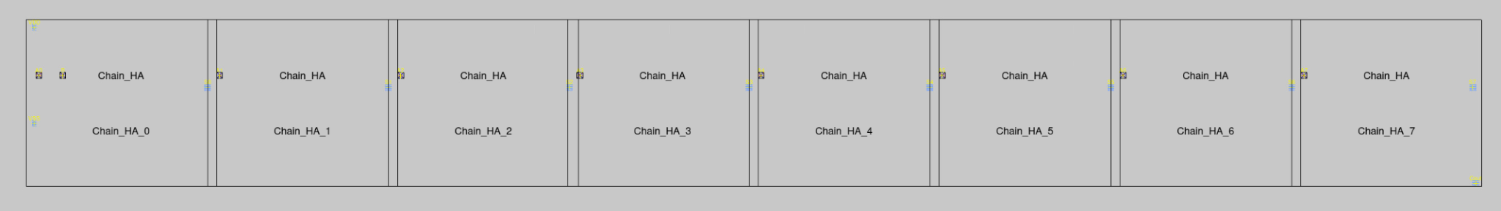
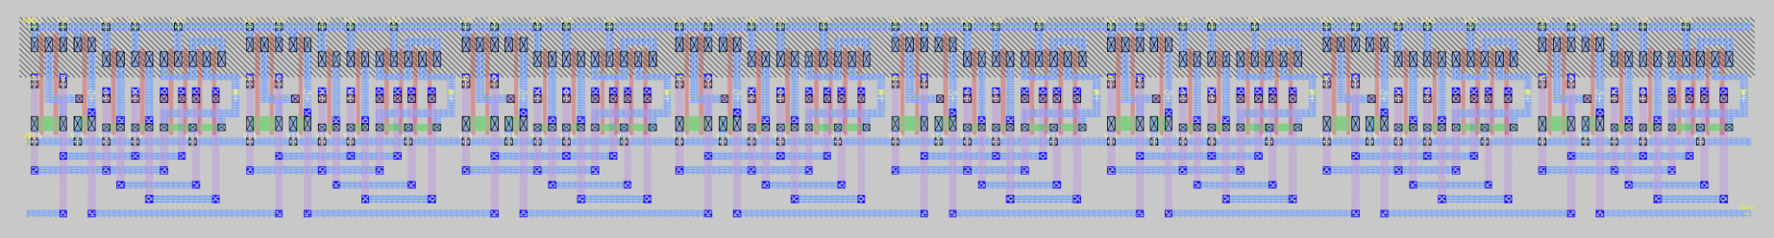
8-bit Adder

Slide 10
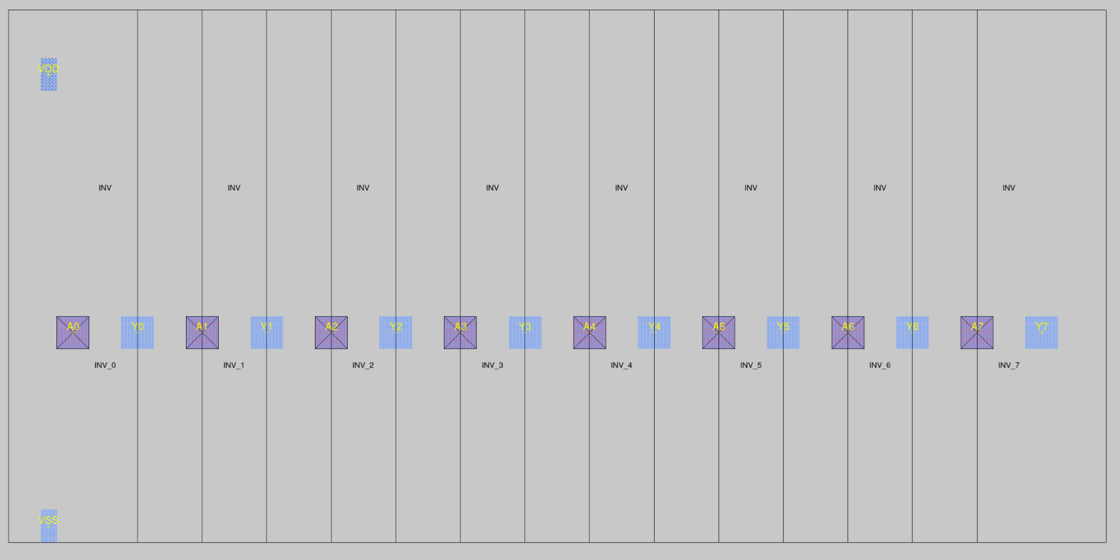
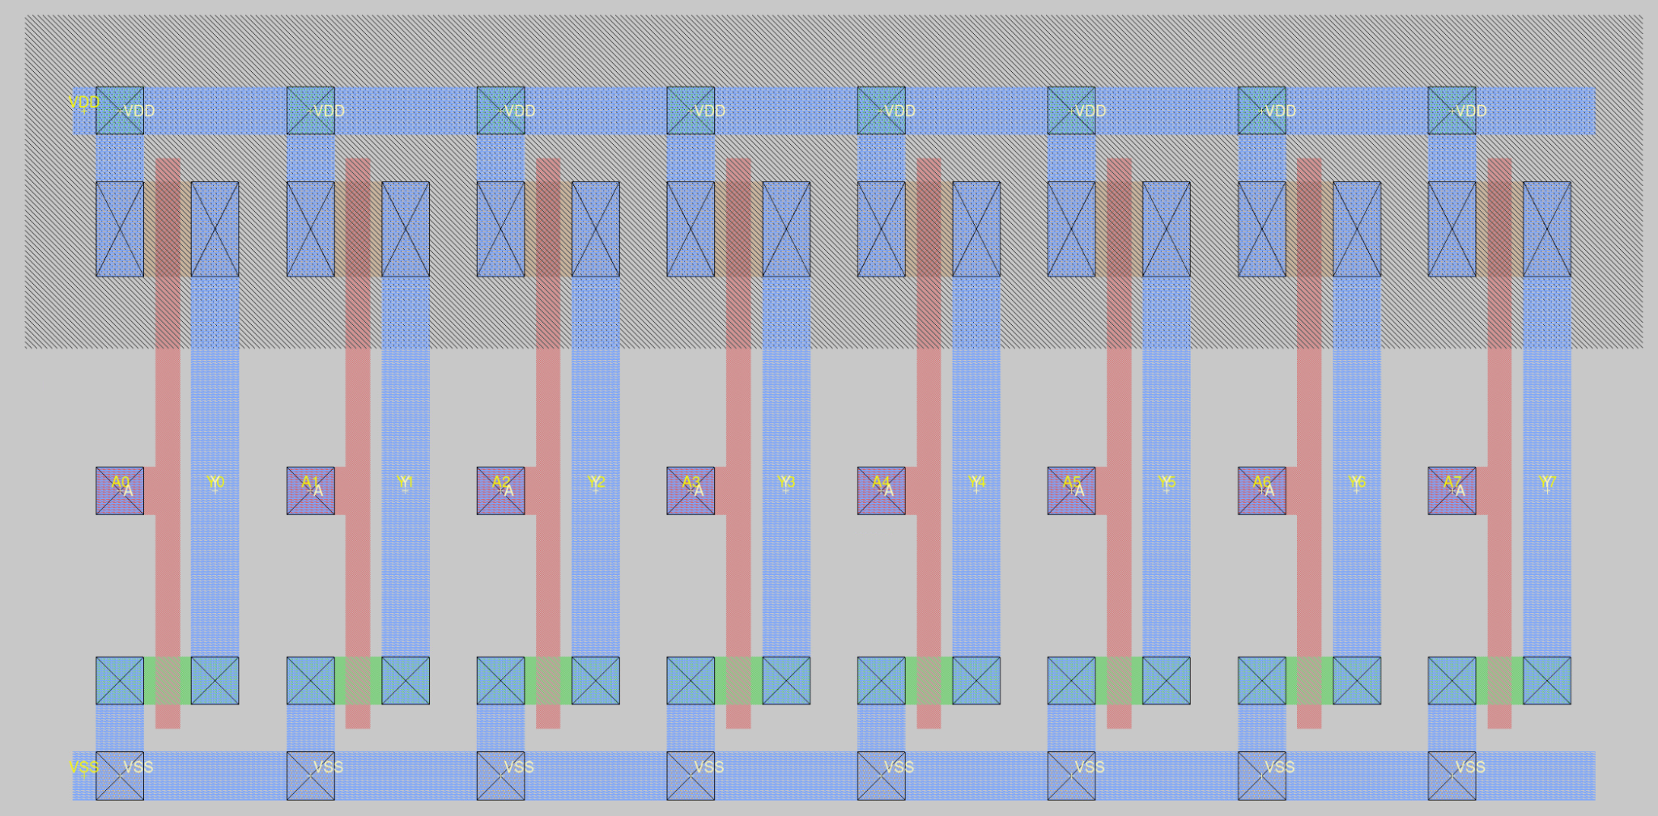
8-bit Inverter

Slide 11
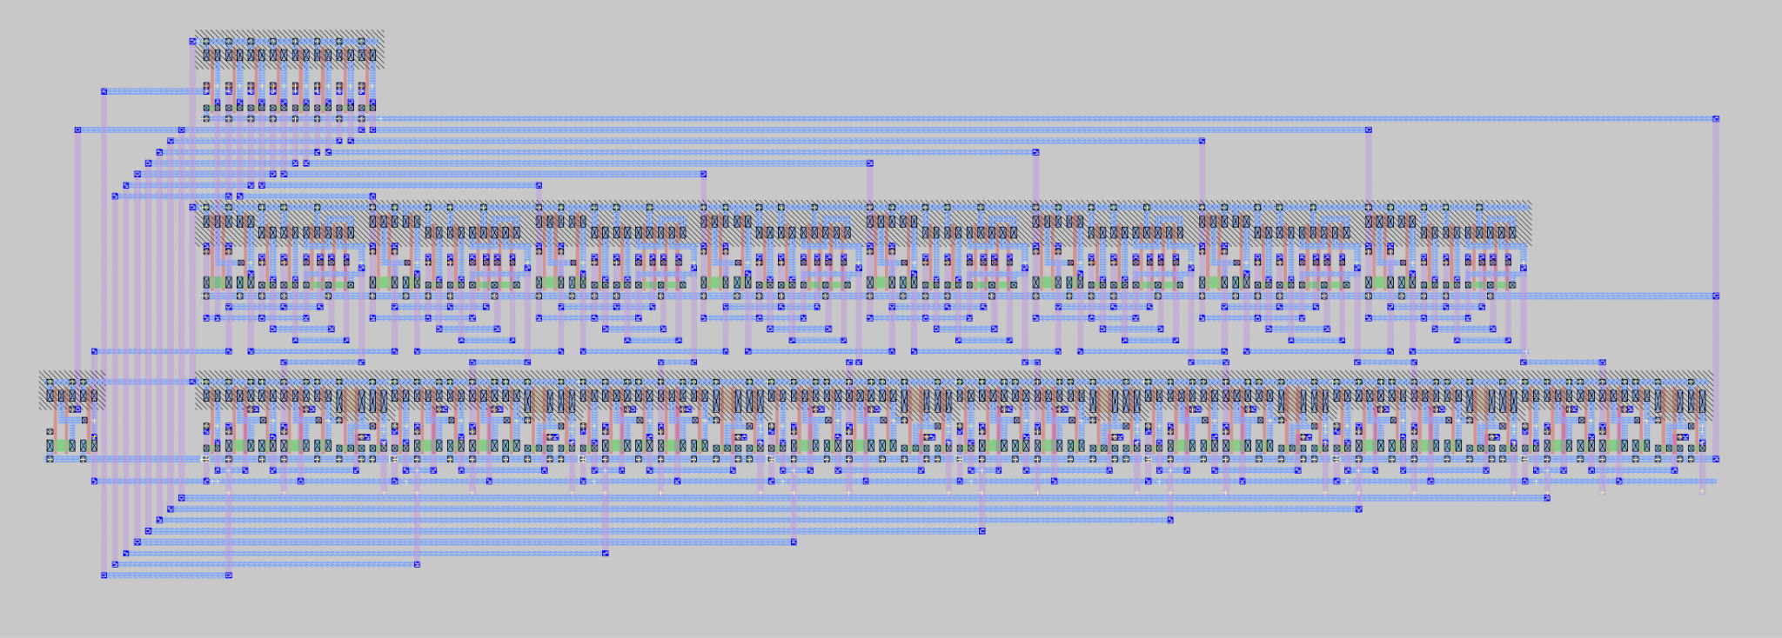
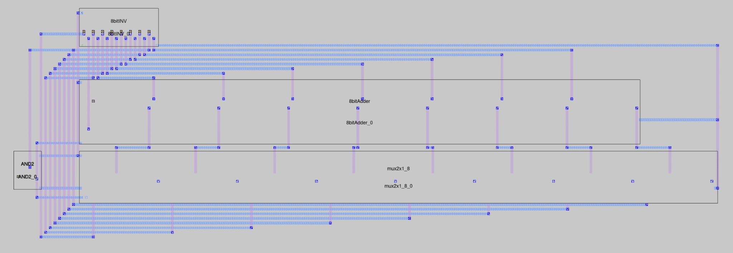
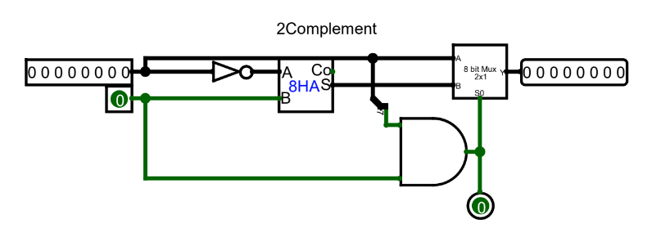
8-bit 2’s Complement

Slide 12
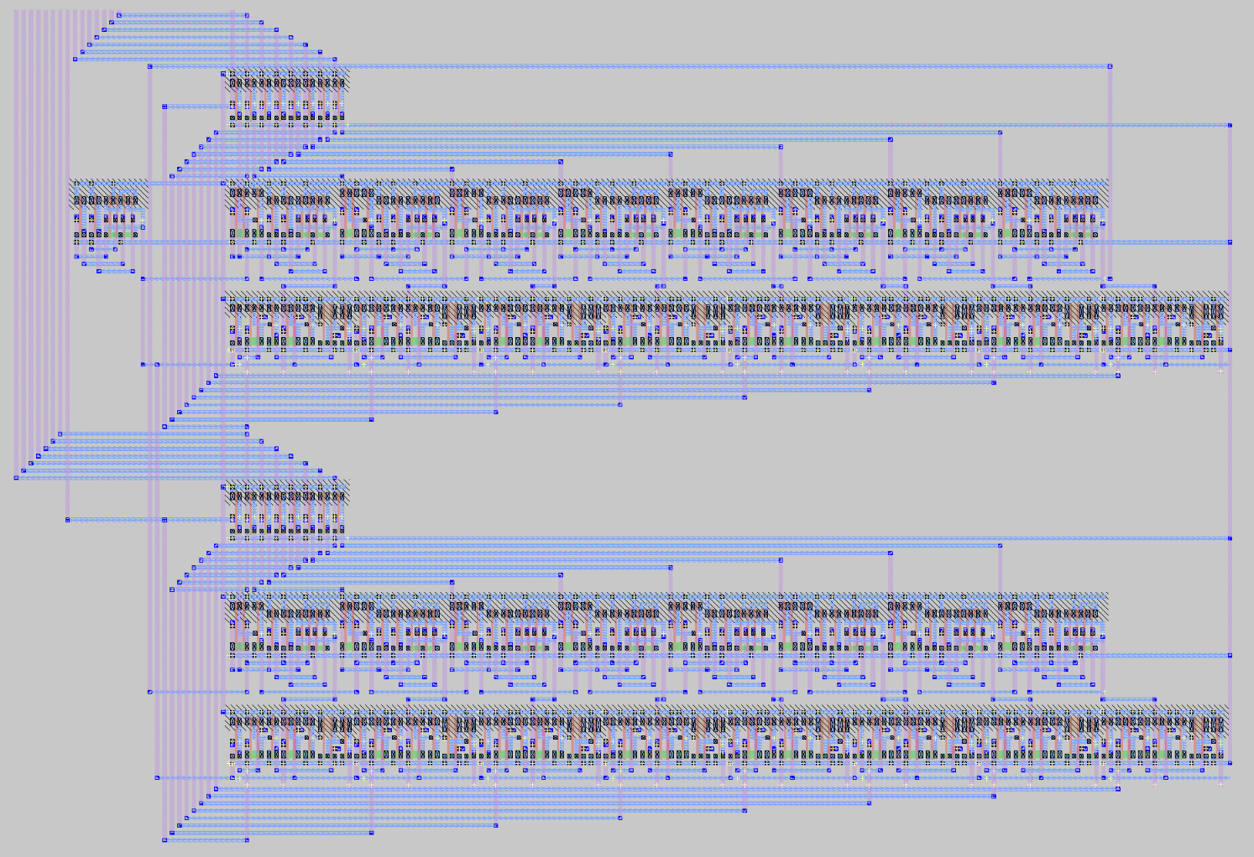
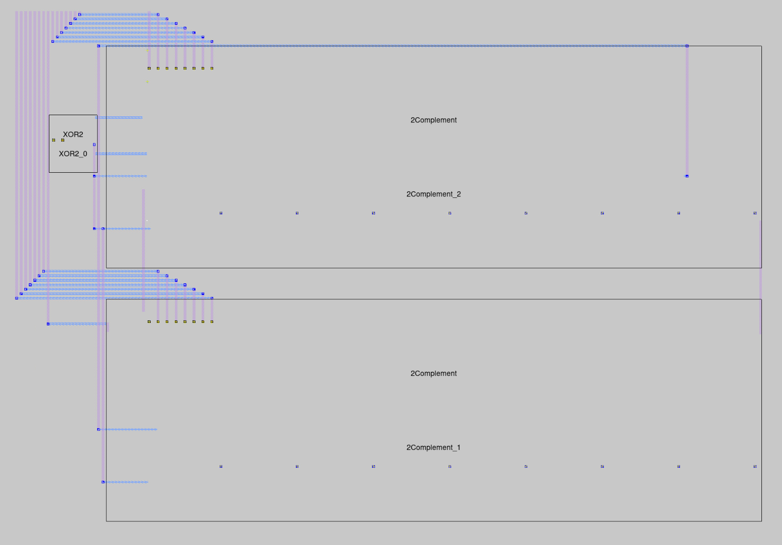
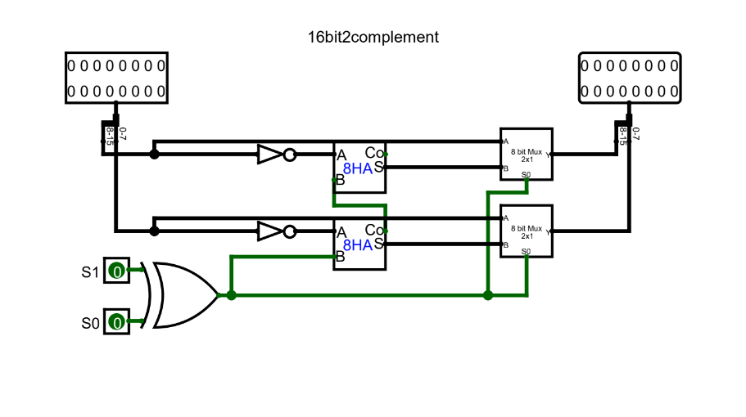
16-bit 2’s Complement

Slide 13
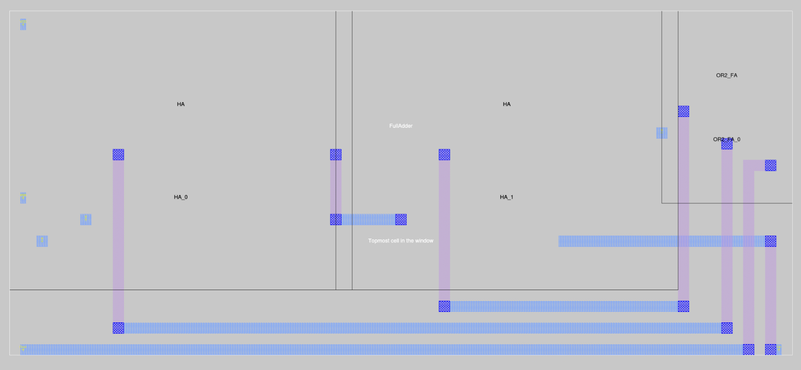
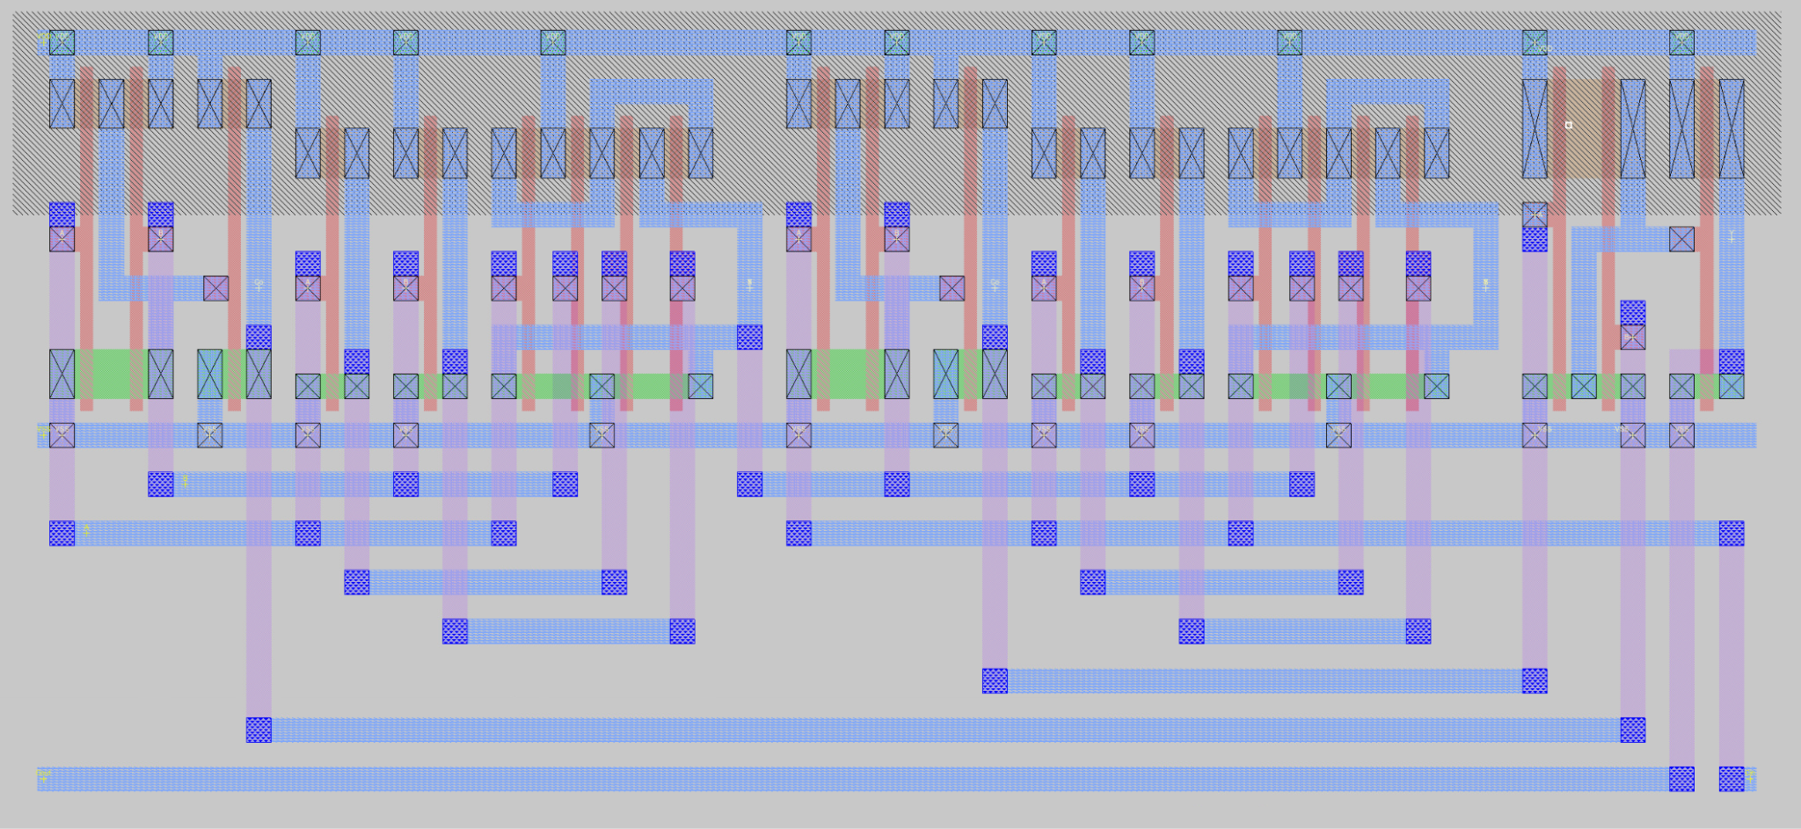
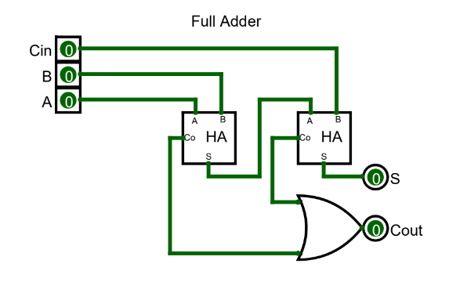
Full Adder
Notes:
Same as M_FA but made M_FA for Mult incase FA needed elsewhere

Slide 14
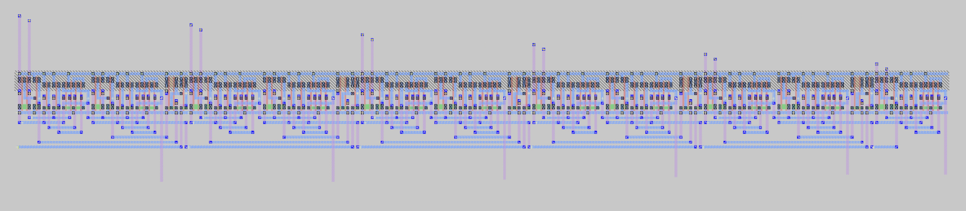
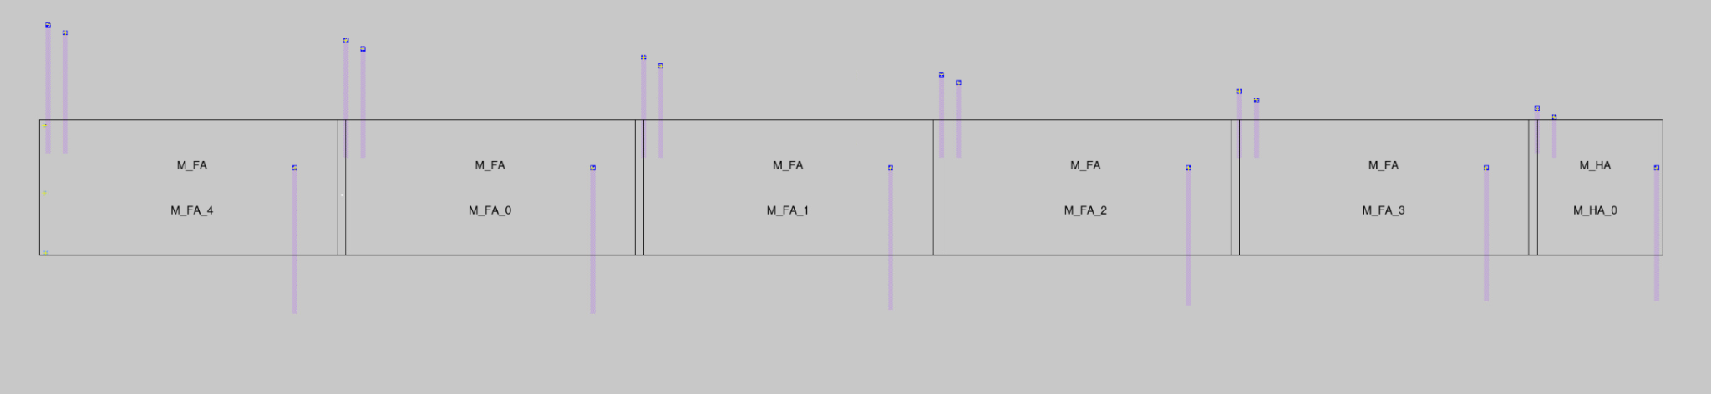
6 Adder

Slide 15
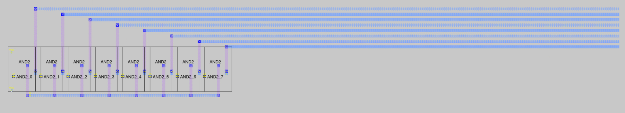
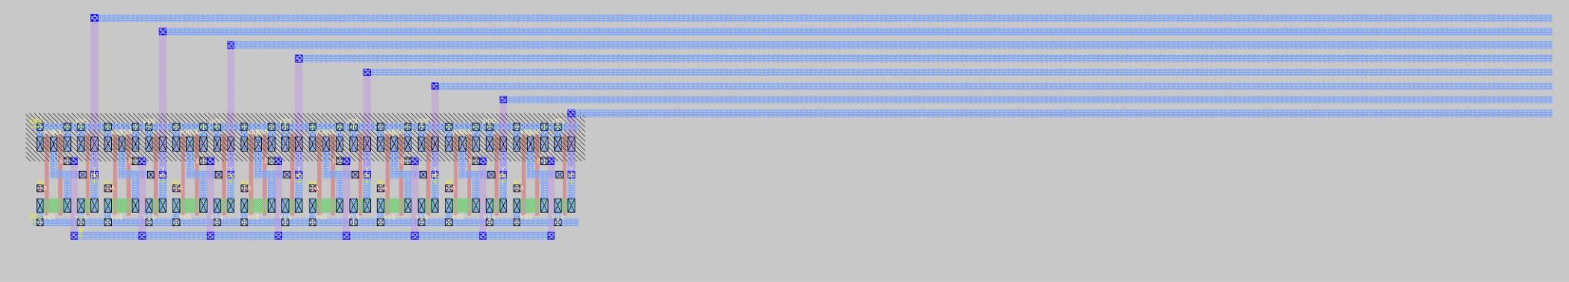
8-bit AND

Slide 16
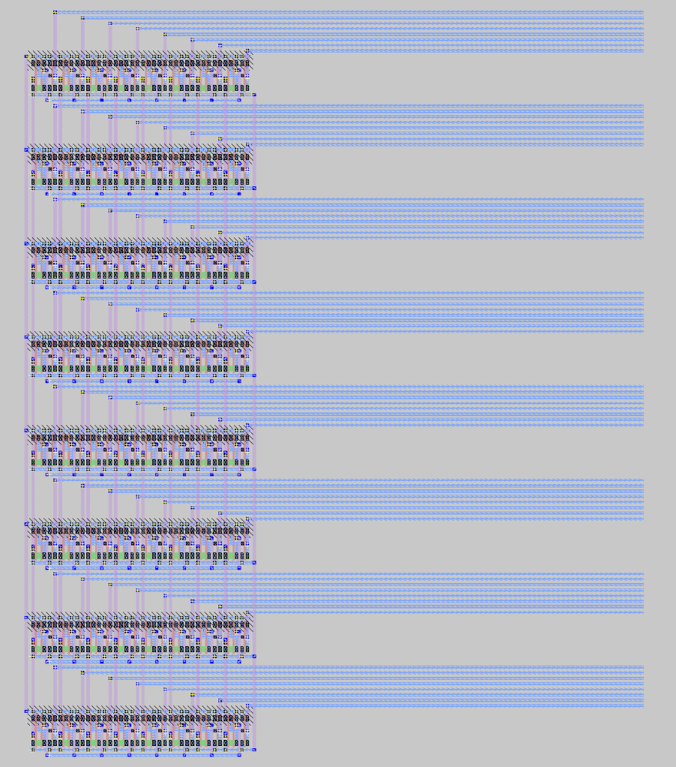
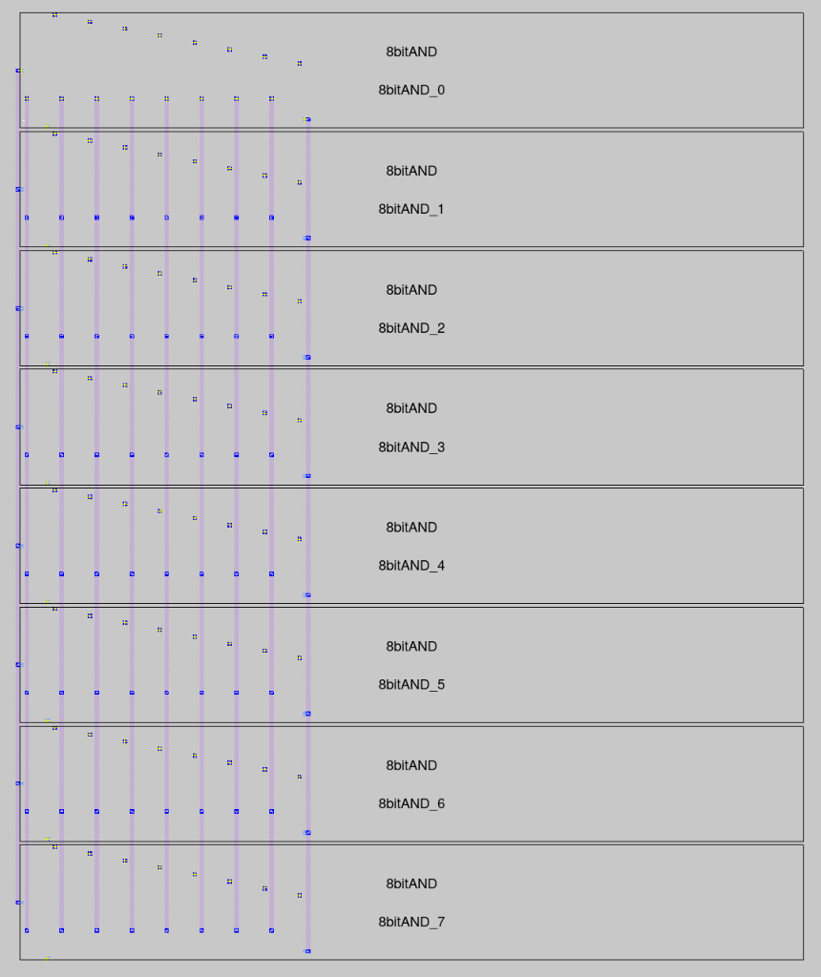
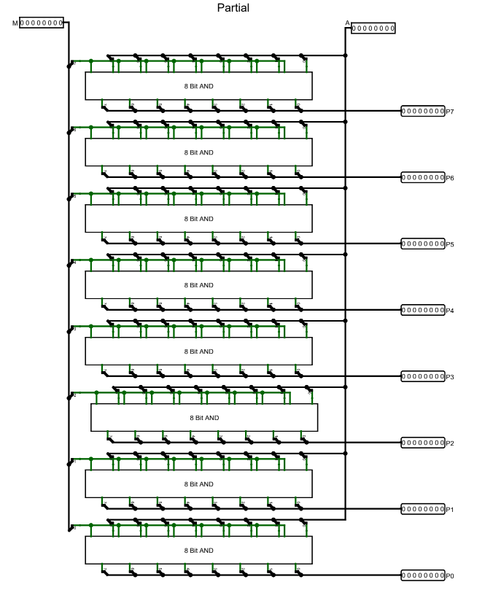
Partial Product
 |  |  |  |  |  |  |  | 0 | 1 | 1 | 0 | 1 | 0 | 0 | 1
 |  |  |  |  |  |  |  | 0 | 1 | 1 | 0 | 0 | 1 | 1 | 0
0 |  |  |  |  |  |  |  | 0 | 0 | 0 | 0 | 0 | 0 | 0 | 0
1 |  |  |  |  |  |  | 0 | 1 | 1 | 0 | 1 | 0 | 0 | 1
2 |  |  |  |  |  | 0 | 1 | 1 | 0 | 1 | 0 | 0 | 1
3 |  |  |  |  | 0 | 0 | 0 | 0 | 0 | 0 | 0 | 0
4 |  |  |  | 0 | 0 | 0 | 0 | 0 | 0 | 0 | 0
5 |  |  | 0 | 1 | 1 | 0 | 1 | 0 | 0 | 1
6 |  | 0 | 1 | 1 | 0 | 1 | 0 | 0 | 1
7 | 0 | 0 | 0 | 0 | 0 | 0 | 0 | 0
0 | 0 | 1 | 0 | 1 | 0 | 0 | 1 | 1 | 1 | 0 | 1 | 0 | 1 | 1 | 0

Slide 17
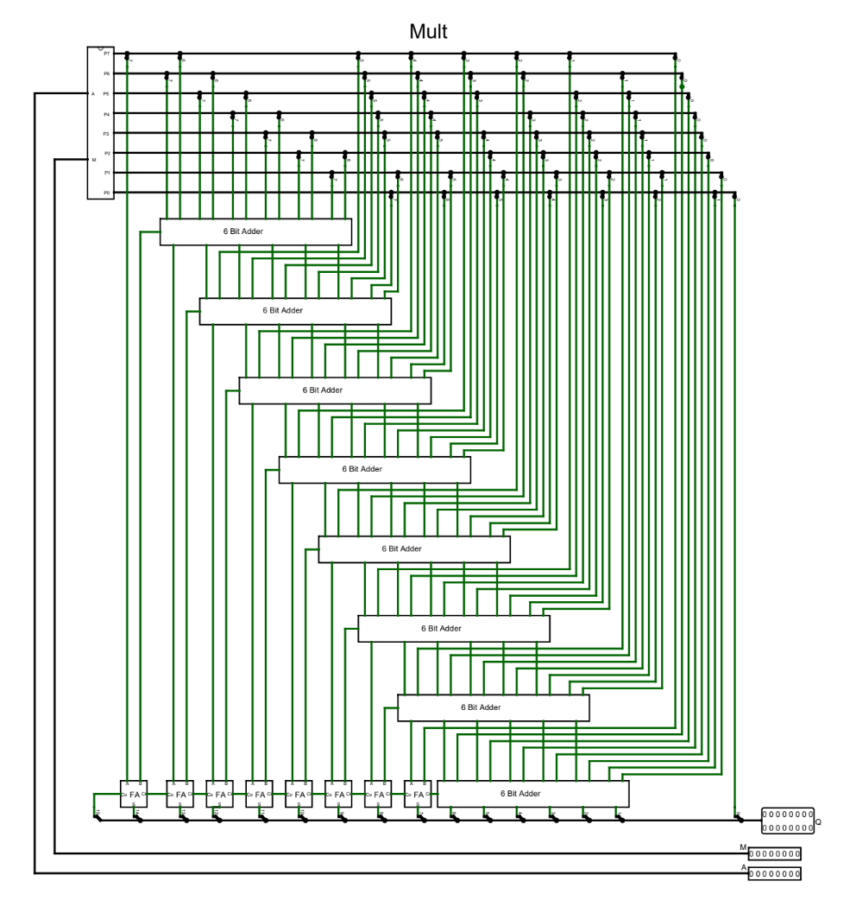
Multiplier
The Wallace tree is made of cascading half and full adders. The AND gates(Partial) are diagrammed in the top left, and their outputs are pulled down into the adder tree according to their “weights.”
Weight = M + N
Where M is a position 0-7 for A,
and N is 0-7 for B
weight(A[7], B[5]) = 7 + 5 = 12
weight(A[2], B[0]) = 2 + 0 = 2

Slide 18
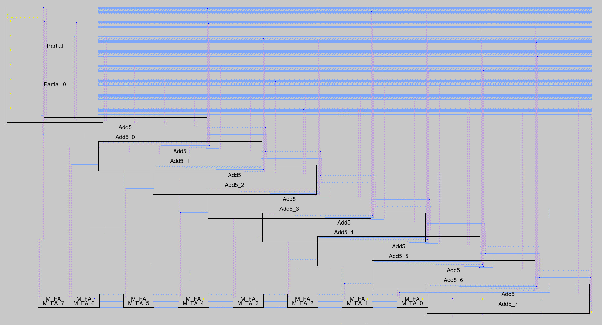
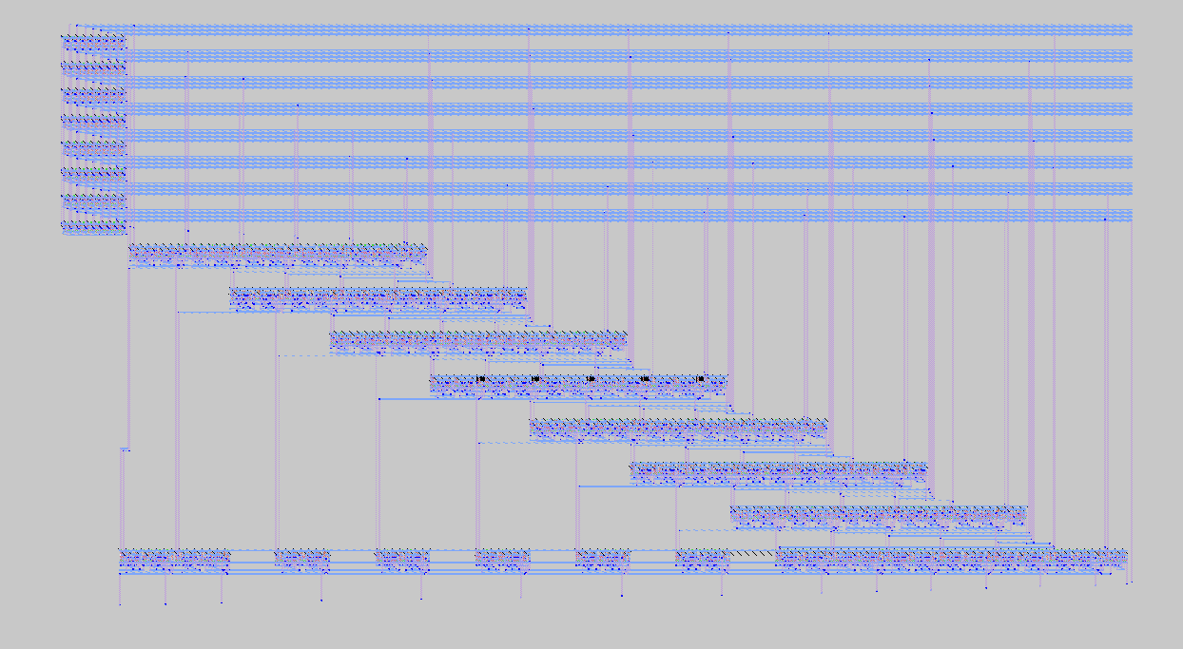
Multiplier

Slide 19
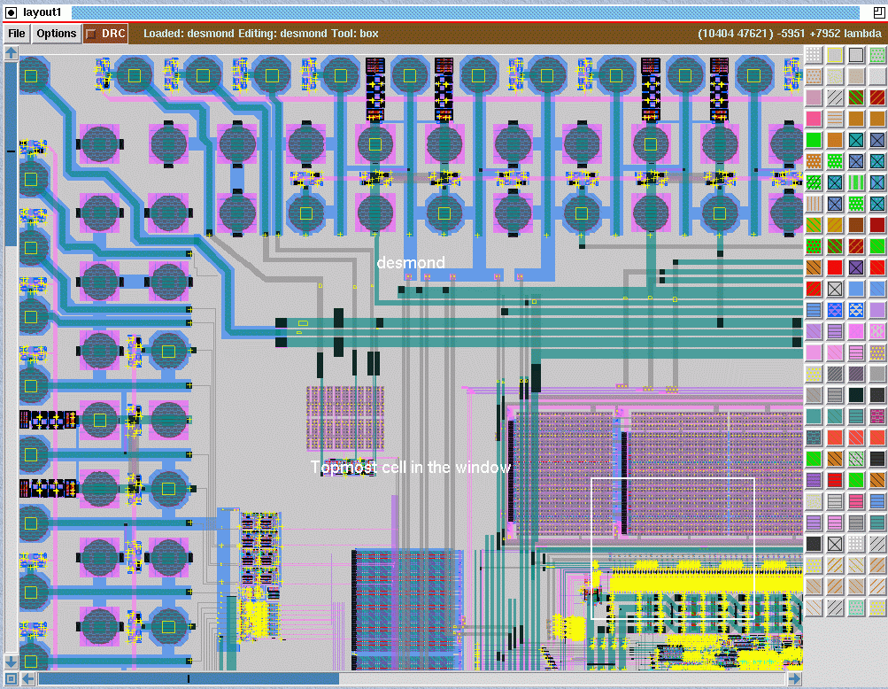
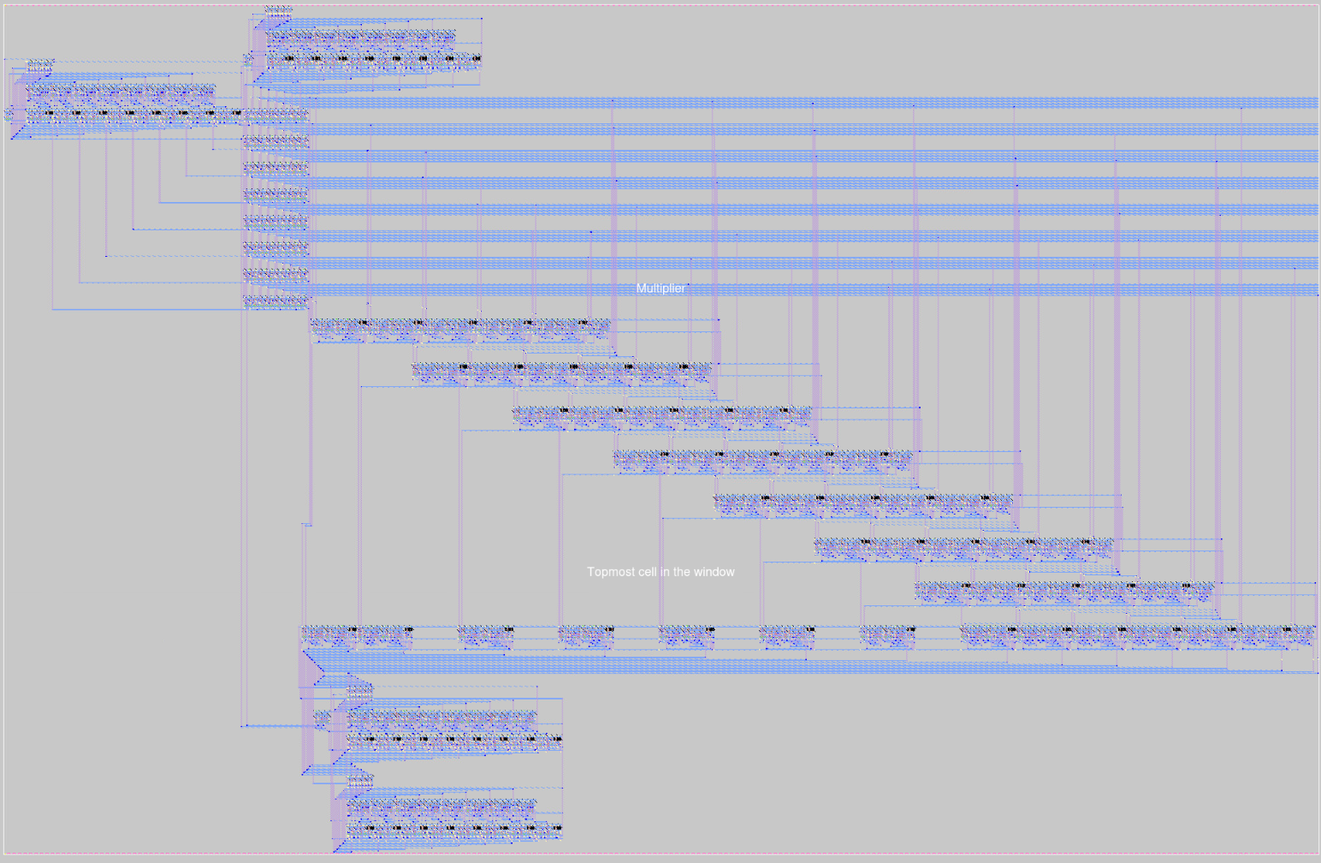
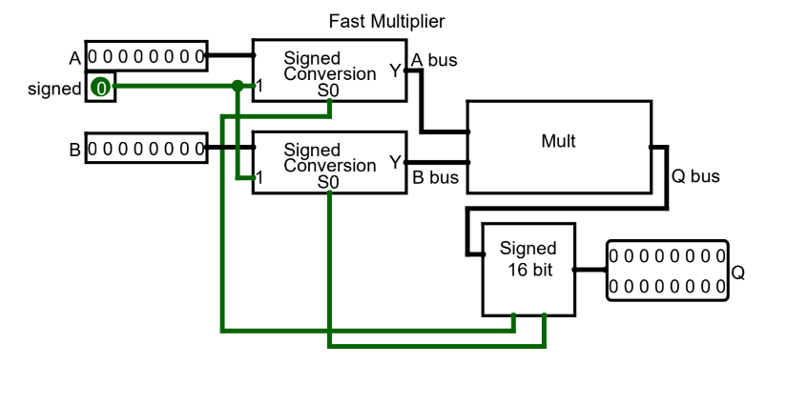
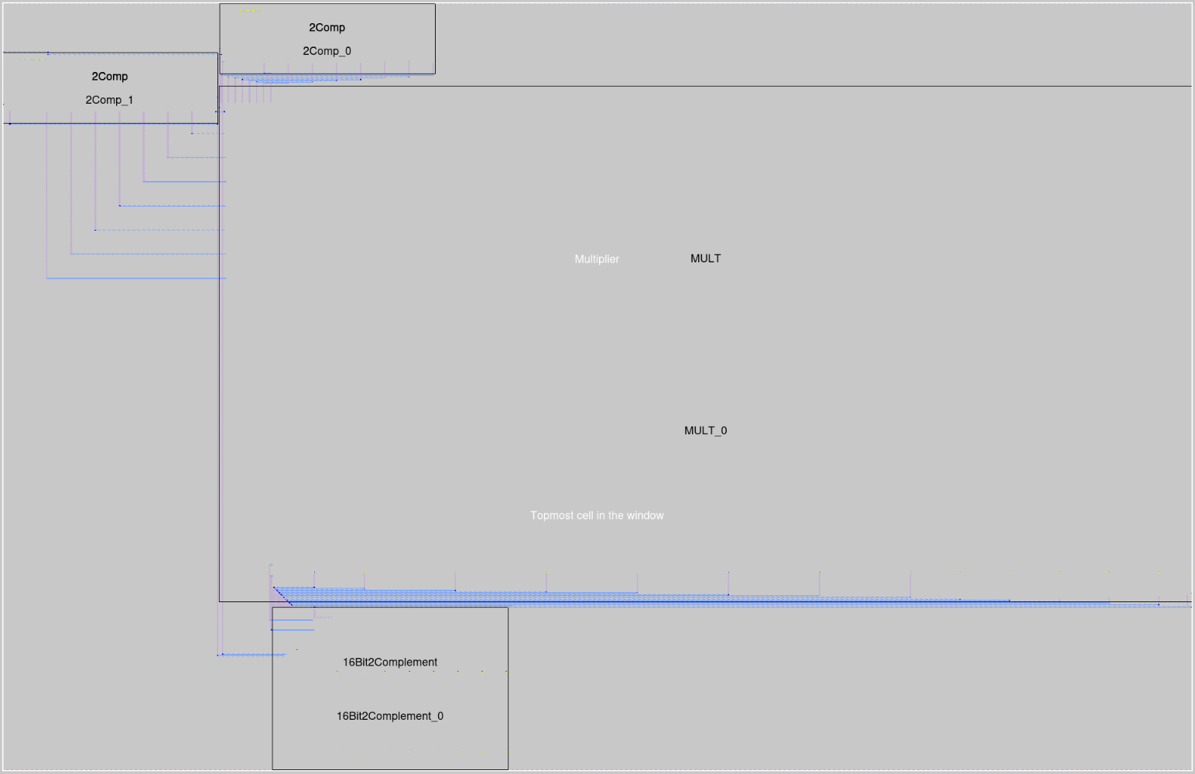
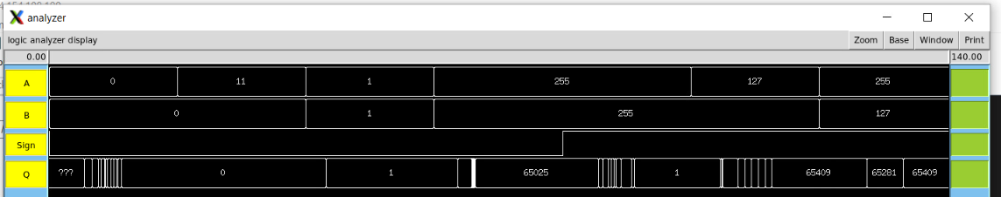
8-bit Fast Multiplier

Slide 20
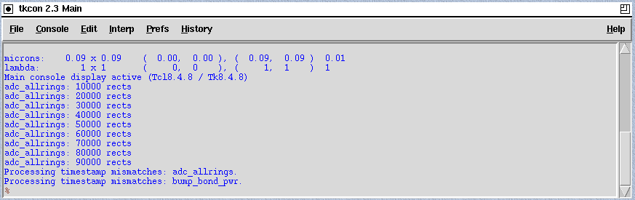
Parts | Assigned Members
Logisim Schematic | Riley, Alberto
Basic gates | Dang
2x1 MUX | Dang
Half and Full Adder | Alberto
8 and 16 bit 2’s Complement | Alberto
Partial Product | Alberto
Multiplier | Riley

Slide 21
Thank you for listening
"This presentation was brought to you by…"
Riley Guidry
Alberto Rosas
Dang Tran
All made possible with…

Slide 22
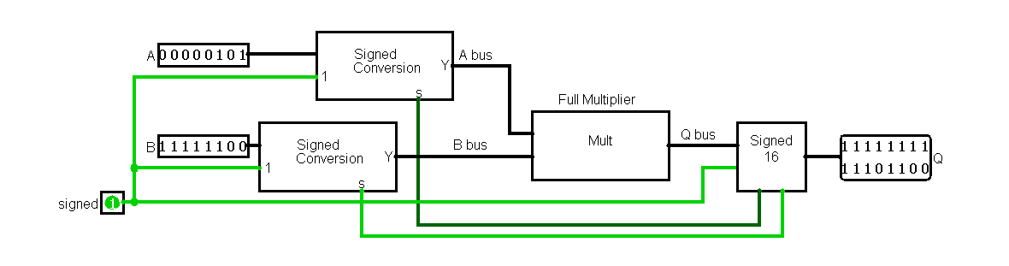
8-bit Fast Multiplier

